Slide 1
Lecture 2: Linear Algebra Primer
Harbin Institute of Technology（Shenzhen）
Jingyong Su
sujingyong@hit.edu.cn

Slide 2
Outline
Vectors and matrices
Basic Matrix Operations
Special Matrices
Transformation Matrices
Homogeneous coordinates
Translation
Matrix inverse
Matrix rank
Singular Value Decomposition (SVD)
Use for image compression
Use for Principal Component Analysis (PCA)
Computer algorithm

Slide 3
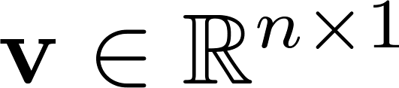
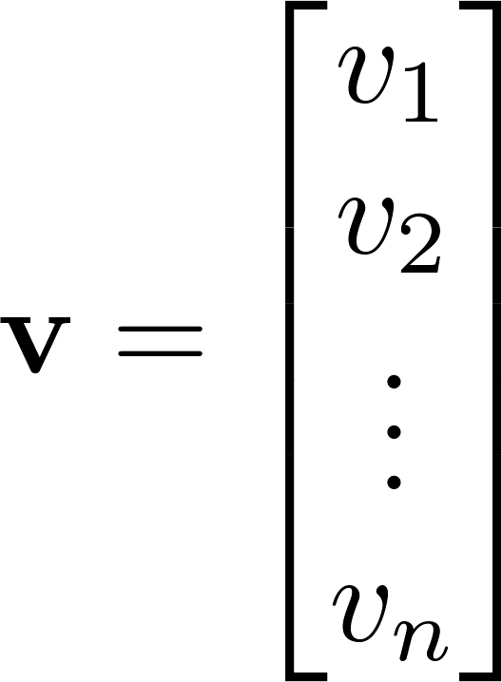
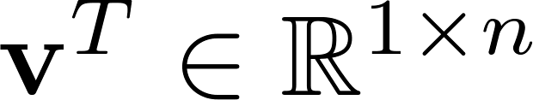
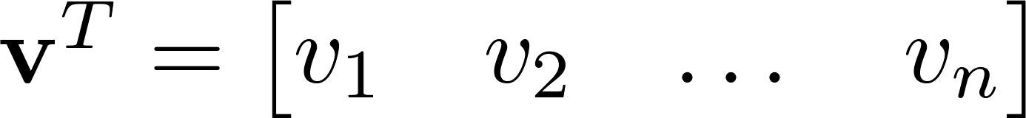

Vector
A column vector where
A row vector where
denotes the transpose operation

Slide 4
Vector
We’ll default to column vectors in this class
You’ll want to keep track of the orientation of your vectors when programming
You can transpose a vector V in MATLAB by writing V’. (But in class materials, we will always use V^{T} to indicate transpose, and we will use V’ to mean “V prime”)

Slide 5

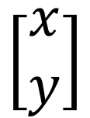
Vectors have two main uses
$$\left[\begin{matrix}x \\ y\end{matrix}\right]$$
Data (pixels, gradients at an image keypoint, etc) can also be treated as a vector
Such vectors don’t have a geometric interpretation, but calculations like “distance” can still have value
Vectors can represent an offset in 2D or 3D space
Points are just vectors from the origin

Slide 6
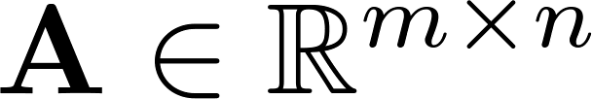
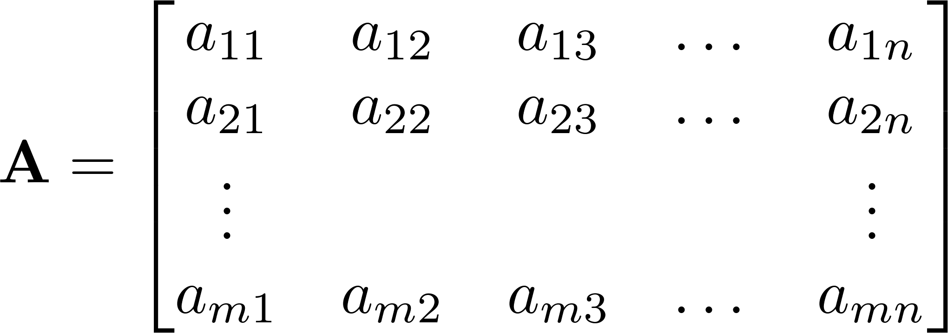


Matrix
A matrix is an array of numbers with m rows and n columns.
If , we say that is square.

Slide 7

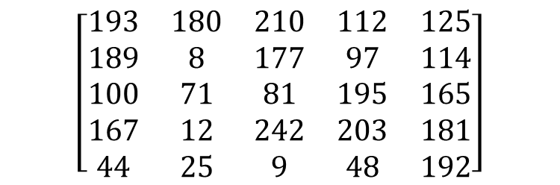
Images
=
$$\left[\begin{matrix}193 & 180 & 210 & 112 & 125 \\ 189 & 8 & 177 & 97 & 114 \\ 100 & 71 & 81 & 195 & 165 \\ 167 & 12 & 242 & 203 & 181 \\ 44 & 25 & 9 & 48 & 192\end{matrix}\right]$$
MATLAB represents an image as a matrix of pixel brightness
Note that matrix coordinates are NOT Cartesian coordinates. The upper left corner is [y, x] = (1,1)

Slide 8
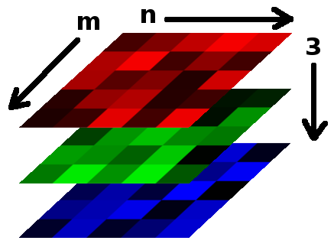

Color Images
Grayscale images have one number per pixel, and are stored as an m × n matrix.
Color images have 3 numbers per pixel – red, green, and blue brightness
Stored as an m × n × 3 matrix
=

Slide 9
Basic Matrix Operations
We will discuss:
Addition
Scaling
Dot product
Multiplication
Transpose
Inverse / pseudoinverse
Determinant / trace

Slide 10
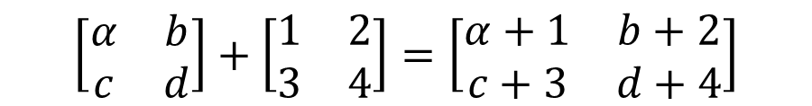

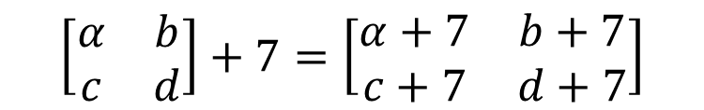
Matrix Operations
Addition
Can only add a matrix with matching dimensions, or a scalar.
Scaling
$$\left[\begin{matrix}α & b \\ c & d\end{matrix}\right]+\left[\begin{matrix}1 & 2 \\ 3 & 4\end{matrix}\right]=\left[\begin{matrix}α+1 & b+2 \\ c+3 & d+4\end{matrix}\right]$$
$$\left[\begin{matrix}α & b \\ c & d\end{matrix}\right]+7=\left[\begin{matrix}α+7 & b+7 \\ c+7 & d+7\end{matrix}\right]$$
$$\left[\begin{matrix}α & b \\ c & d\end{matrix}\right]×3=\left[\begin{matrix}3α & 3b \\ 3c & 3d\end{matrix}\right]$$

Slide 11
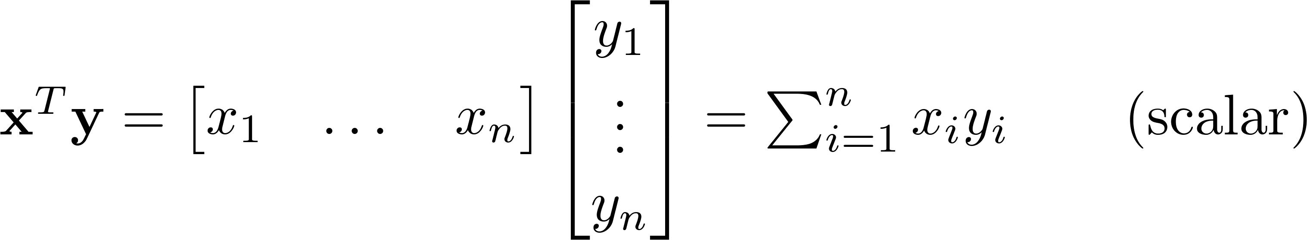
Matrix Operations
Inner product (dot product) of vectors
Multiply corresponding entries of two vectors and add up the result
x·y is also |x||y|cos( the angle between x and y )

Slide 12
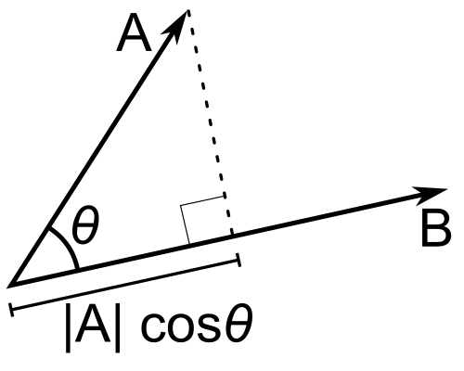
Matrix Operations
Inner product (dot product) of vectors
If B is a unit vector, then A·B gives the length of A which lies in the direction of B

Slide 13
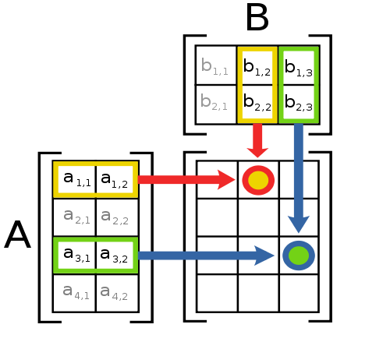
Matrix Operations
Multiplication
The product AB is:
Each entry in the result is (that row of A) dot product with (that column of B)
Many uses, which will be covered later

Slide 14
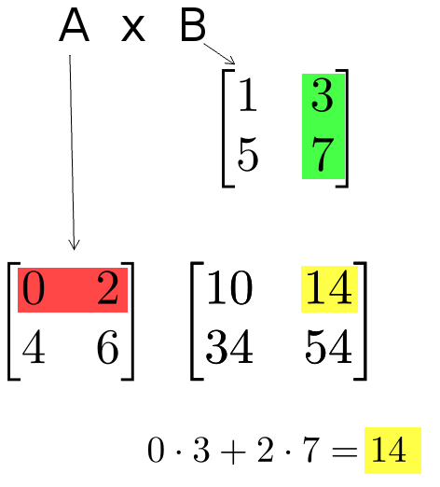
Matrix Operations
Multiplication example:
Each entry of the matrix product is made by taking the dot product of the corresponding row in the left matrix, with the corresponding column in the right one.

Slide 15
Matrix Operations
Powers
By convention, we can refer to the matrix product AA as A², and AAA as A³, etc.
Obviously only square matrices can be multiplied that way

Slide 16
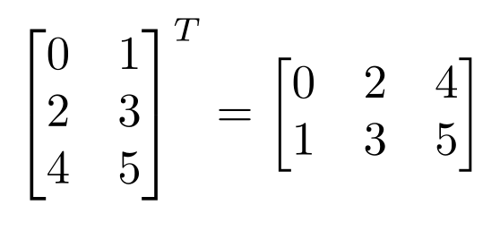
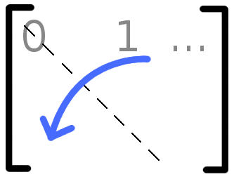

Matrix Operations
Transpose – flip matrix, so row 1 becomes column 1
A useful identity:

Slide 17
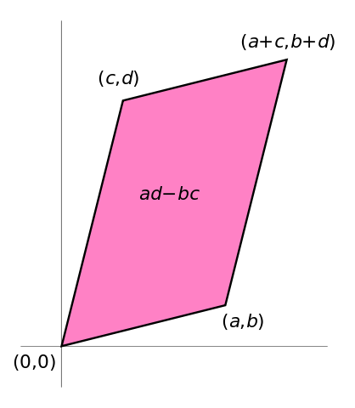
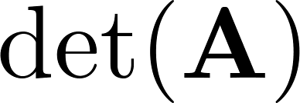
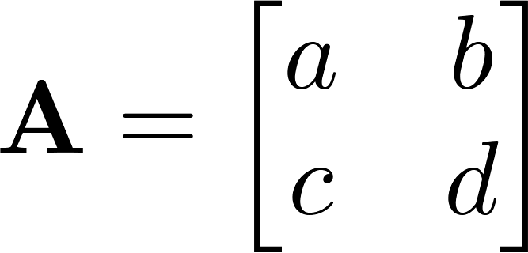

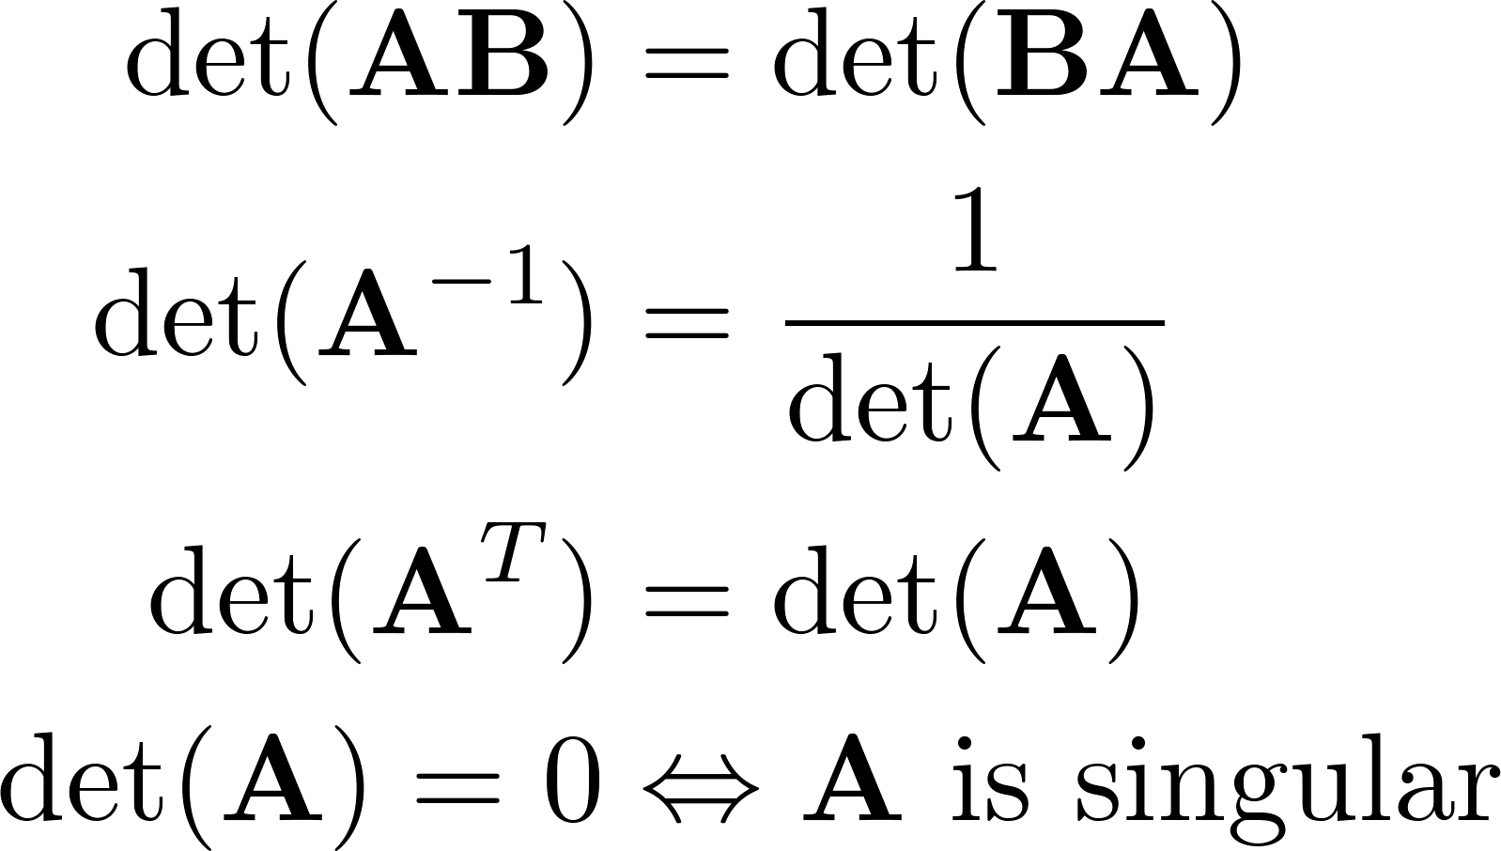
Matrix Operations
Determinant
returns a scalar
Represents area (or volume) of the parallelogram described by the vectors in the rows of the matrix
For ,
Properties:

Slide 18
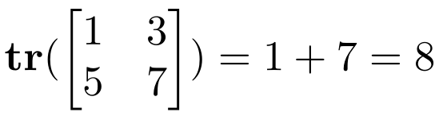
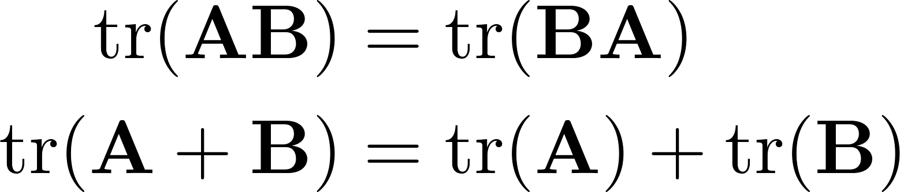
Matrix Operations
Trace
Invariant to a lot of transformations, so it’s used sometimes in proofs. (Rarely in this class though.)
Properties:

Slide 19
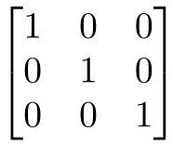
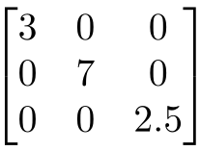
Special Matrices
Identity matrix I
Square matrix, 1’s along diagonal, 0’s elsewhere
I ∙ [another matrix] = [that matrix]
Diagonal matrix
Square matrix with numbers along diagonal, 0’s elsewhere
A diagonal ∙ [another matrix] scales the rows of that matrix

Slide 20
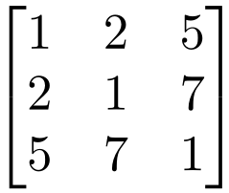

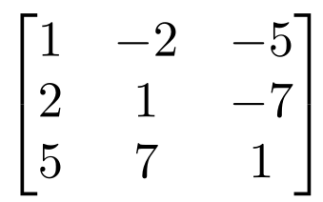

Special Matrices
Symmetric matrix
Skew-symmetric matrix

Slide 21
Outline
Vectors and matrices
Basic Matrix Operations
Special Matrices
Transformation Matrices
Homogeneous coordinates
Translation
Matrix inverse
Matrix rank
Singular Value Decomposition (SVD)
Use for image compression
Use for Principal Component Analysis (PCA)
Computer algorithm

Slide 22
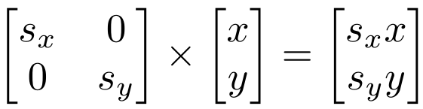
Transformation
Matrices can be used to transform vectors in useful ways, through multiplication: x’= Ax
Simplest is scaling:
(Verify to yourself that the matrix multiplication works out this way)

Slide 23
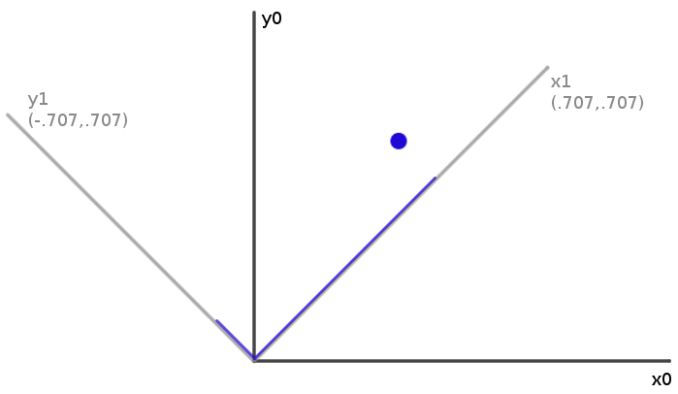
Rotation
How can you convert a vector represented in frame “0” to a new, rotated coordinate frame “1”?
Remember what a vector is: [component in direction of the frame’s x axis, component in direction of y axis]

Slide 24
Rotation
So to rotate it we must produce this vector: [component in direction of new x axis, component in direction of new y axis]
We can do this easily with dot products!
New x coordinate is [original vector] dot [the new x axis]
New y coordinate is [original vector] dot [the new y axis]

Slide 25
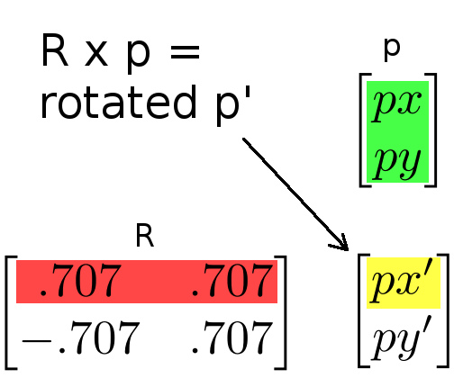
Rotation
Insight: this is what happens in a matrix*vector multiplication
Result x coordinate is [original vector] dot [matrix row 1]
So matrix multiplication can rotate a vector p:

Slide 26
Rotation
Suppose we express a point in a coordinate system which is rotated left
If we use the result in the same coordinate system, we have rotated the point right
Thus, rotation matrices can be used to rotate vectors. We’ll usually think of them in that sense-- as operators to rotate vectors

Slide 27
2D Rotation Matrix Formula
Counter-clockwise rotation by an angle θ
P’
y’
θ
y
P
x’
x

Slide 28
Transformation Matrices
Multiple transformation matrices can be used to transform a point: p’=R₂ R₁ S p
The effect of this is to apply their transformations one after the other, from right to left.
In the example above, the result is (R₂ (R₁ (S p)))
The result is exactly the same if we multiply the matrices first, to form a single transformation matrix: p’=(R₂ R₁ S) p

Slide 29
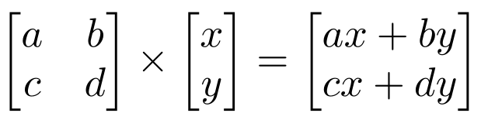
Homogeneous system
In general, a matrix multiplication lets us linearly combine components of a vector
This is sufficient for scale, rotate, skew transformations.
But notice, we can’t add a constant! ☹

Slide 30
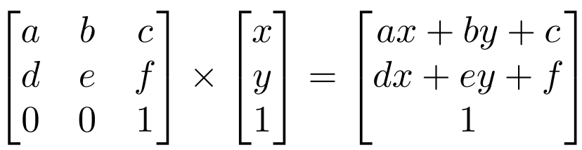
Homogeneous system
The (somewhat hacky) solution? Stick a “1” at the end of every vector:
Now we can rotate, scale, and skew like before, AND translate (note how the multiplication works out, above)
This is called “homogeneous coordinates”

Slide 31
Homogeneous system
In homogeneous coordinates, the multiplication works out so the rightmost column of the matrix is a vector that gets added.
Generally, a homogeneous transformation matrix will have a bottom row of [0 0 1], so that the result has a “1” at the bottom too.

Slide 32
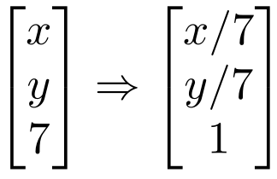
Homogeneous system
One more thing we might want: to divide the result by something
For example, we may want to divide by a coordinate, to make things scale down as they get farther away in a camera image
Matrix multiplication can’t actually divide
So, by convention, in homogeneous coordinates, we’ll divide the result by its last coordinate after doing a matrix multiplication

Slide 33
2D Translation
P’
P
t

Slide 34
2D Translation using Homogeneous Coordinates
P’
t
t
ty
P
P
y
x
tx

Slide 35
Scaling
P’
P

Slide 36
Scaling Equation
P’
s_{y} y
P
y
x
s_{x} x

Slide 37
Scaling & Translating
P’’
P
P’=S∙P
P’’=T∙P’
P’’=T ∙ P’=T ∙(S ∙ P)= T ∙ S ∙P = A ∙ P

Slide 38
Scaling & Translating
A

Slide 39
Translating & Scaling != Scaling & Translating

Slide 40
Rotation
P’
P

Slide 41
Rotation Equations
Counter-clockwise rotation by an angle θ
P’
y’
θ
y
P
x’
x

Slide 42
Rotation Matrix Properties
Transpose of a rotation matrix produces a rotation in the opposite direction
The rows of a rotation matrix are always mutually perpendicular (a.k.a. orthogonal) unit vectors
(and so are its columns)

Slide 43
Properties
A 2D rotation matrix is 2x2
Note: R belongs to the category of normal matrices
and satisfies many interesting properties:

Slide 44
Rotation+ Scaling +Translation
P’= (T R S) P
This is the form of the general-purpose transformation matrix

Slide 45
Outline
Vectors and matrices
Basic Matrix Operations
Special Matrices
Transformation Matrices
Homogeneous coordinates
Translation
Matrix inverse
Matrix rank
Singular Value Decomposition (SVD)
Use for image compression
Use for Principal Component Analysis (PCA)
Computer algorithm

Slide 46
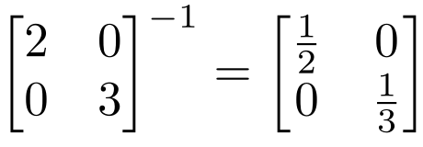
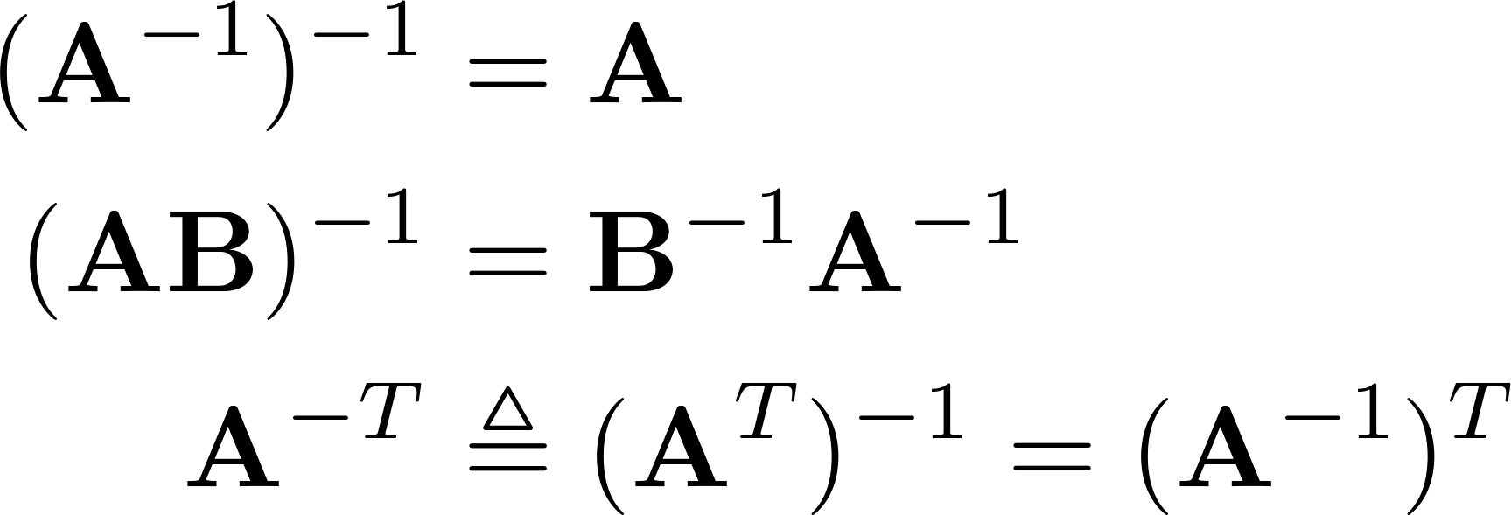
Inverse
Given a matrix A, its inverse A⁻¹ is a matrix such that AA⁻¹ = A⁻¹A = I
E.g.
Inverse does not always exist. If A⁻¹ exists, A is invertible or non-singular. Otherwise, it’s singular.
Useful identities, for matrices that are invertible:

Slide 47
Matrix Operations
Pseudoinverse
Say you have the matrix equation AX=B, where A and B are known, and you want to solve for X
You could use MATLAB to calculate the inverse and premultiply by it: A⁻¹AX=A⁻¹B → X=A⁻¹B
MATLAB command would be inv(A)*B
But calculating the inverse for large matrices often brings problems with computer floating-point resolution (because it involves working with very small and very large numbers together).
Or, your matrix might not even have an inverse.

Slide 48
Matrix Operations
Pseudoinverse
Fortunately, there are workarounds to solve AX=B in these situations. And MATLAB can do them!
Instead of taking an inverse, directly ask MATLAB to solve for X in AX=B, by typing A\B
MATLAB will try several appropriate numerical methods (including the pseudoinverse if the inverse doesn’t exist)
MATLAB will return the value of X which solves the equation
If there is no exact solution, it will return the closest one
If there are many solutions, it will return the smallest one

Slide 49

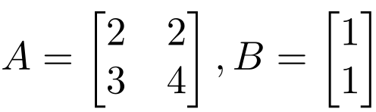
Matrix Operations
MATLAB example:
>> x = A\B
x =
1.0000
-0.5000

Slide 50
Outline
Vectors and matrices
Basic Matrix Operations
Special Matrices
Transformation Matrices
Homogeneous coordinates
Translation
Matrix inverse
Matrix rank
Singular Value Decomposition (SVD)
Use for image compression
Use for Principal Component Analysis (PCA)
Computer algorithm

Slide 51
Linear independence
Suppose we have a set of vectors v₁, …, v_{n}
If we can express v₁ as a linear combination of the other vectors v₂…v_{n}, then v₁ is linearly dependent on the other vectors.
The direction v₁ can be expressed as a combination of the directions v₂, …,v_{n}. (E.g. v₁ = .7 v₂ -.7 v₄)
If no vector is linearly dependent on the rest of the set, the set is linearly independent.
Common case: a set of vectors v₁, …, v_{n} is always linearly independent if each vector is perpendicular to every other vector (and non-zero)

Slide 52
Linear independence
Linearly independent set
Not linearly independent

Slide 53
Matrix rank
Column/row rank
Column rank always equals row rank
Matrix rank

Slide 54
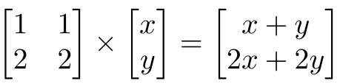
Matrix rank
For transformation matrices, the rank tells you the dimensions of the output
E.g. if rank of A is 1, then the transformation
p’=Ap
maps points onto a line.
Here’s a matrix with rank 1:
All points get mapped to the line y=2x

Slide 55
Matrix rank
If an m x m matrix is rank m, we say it’s “full rank”
Maps an m x 1 vector uniquely to another m x 1 vector
An inverse matrix can be found
If rank < m, we say it’s “singular”
At least one dimension is getting collapsed. No way to look at the result and tell what the input was
Inverse does not exist
Inverse also doesn’t exist for non-square matrices

Slide 56
Outline
Vectors and matrices
Basic Matrix Operations
Special Matrices
Transformation Matrices
Homogeneous coordinates
Translation
Matrix inverse
Matrix rank
Singular Value Decomposition (SVD)
Use for image compression
Use for Principal Component Analysis (PCA)
Computer algorithm

Slide 57
Singular Value Decomposition (SVD)
There are several computer algorithms that can “factor” a matrix, representing it as the product of some other matrices
The most useful of these is the Singular Value Decomposition.
Represents any matrix A as a product of three matrices: UΣV^{T}
MATLAB command: [U,S,V]=svd(A)

Slide 58
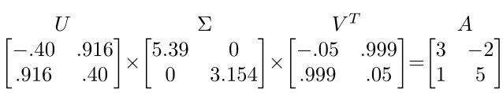
Singular Value Decomposition (SVD)
UΣV^{T} = A
Where U and V are rotation matrices, and Σ is a scaling matrix. For example:

Slide 59
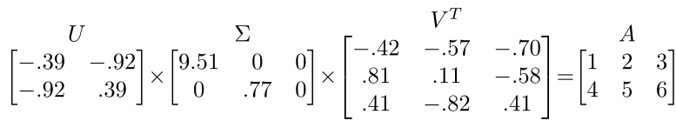
Singular Value Decomposition (SVD)
Beyond 2D:
In general, if A is m x n, then U will be m x m, Σ will be m x n, and V^{T} will be n x n.
(Note the dimensions work out to produce m x n after multiplication)

Slide 60
Singular Value Decomposition (SVD)
U and V are always rotation matrices.
Geometric rotation may not be an applicable concept, depending on the matrix. So we call them “unitary” matrices – each column is a unit vector.
Σ is a diagonal matrix
The number of nonzero entries = rank of A
The algorithm always sorts the entries high to low

Slide 61
SVD Applications
We’ve discussed SVD in terms of geometric transformation matrices
But SVD of an image matrix can also be very useful
To understand this, we’ll look at a less geometric interpretation of what SVD is doing

Slide 62
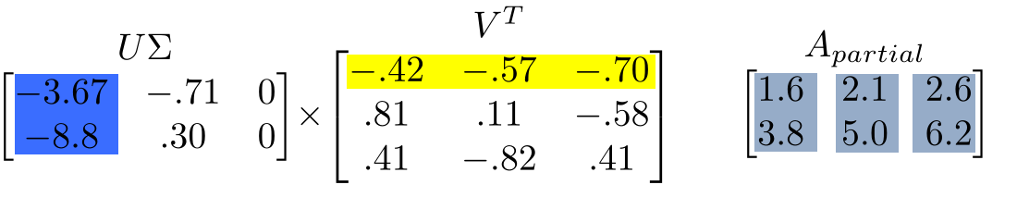
SVD Applications
Look at how the multiplication works out, left to right:
Column 1 of U gets scaled by the first value from Σ.
The resulting vector gets scaled by row 1 of V^{T} to produce a contribution to the columns of A

Slide 63
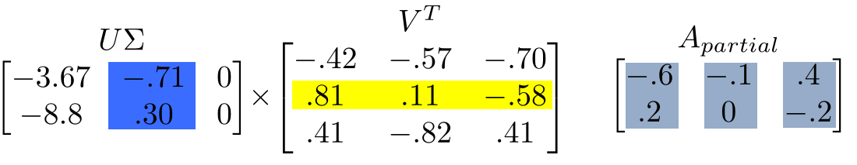
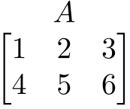
SVD Applications
+
=
Each product of (column i of U)∙(value i from Σ)∙(row i of V^{T}) produces a component of the final A.

Slide 64
SVD Applications
We’re building A as a linear combination of the columns of U
Using all columns of U, we’ll rebuild the original matrix perfectly
But, in real-world data, often we can just use the first few columns of U and we’ll get something close (e.g. the first A_{partial}, above)

Slide 65
SVD Applications
We can call those first few columns of U the Principal Components of the data
They show the major patterns that can be added to produce the columns of the original matrix
The rows of V^{T} show how the principal components are mixed to produce the columns of the matrix

Slide 66
SVD Applications
We can look at Σ to see that the first column has a large effect
while the second column has a much smaller effect in this example

Slide 67
Principal Component Analysis
Remember, columns of U are the Principal Components of the data: the major patterns that can be added to produce the columns of the original matrix
One use of this is to construct a matrix where each column is a separate data sample
Run SVD on that matrix, and look at the first few columns of U to see patterns that are common among the columns
This is called Principal Component Analysis (or PCA) of the data samples

Slide 68
Principal Component Analysis
Often, raw data samples have a lot of redundancy and patterns
PCA can allow you to represent data samples as weights on the principal components, rather than using the original raw form of the data
By representing each sample as just those weights, you can represent just the “meat” of what’s different between samples.
This minimal representation makes machine learning and other algorithms much more efficient

Slide 69
PCA for Images - Setup
Suppose a data set comprising N observations, each of M variables (dimensions).
The aim: to reduce the dimensionality of the data so that each observation can be usefully represented with only L variables, L < M.
Data are arranged as a set of N column data vectors, each representing a single observation of M variables: the n-th observations is a column vector.
We thus have an M x N data matrix X.

Slide 70

PCA for images
Let us consider a 321 x 261 image.
The image is considered as a very long 1D vector by concatenating image pixels column by column (or alternatively row by row), i. e. 321 x 261 = 83781.
The huge number 83781 is the dimensionality of our vector space.
The intensity variation is assumed in each pixel of the image.

Slide 71
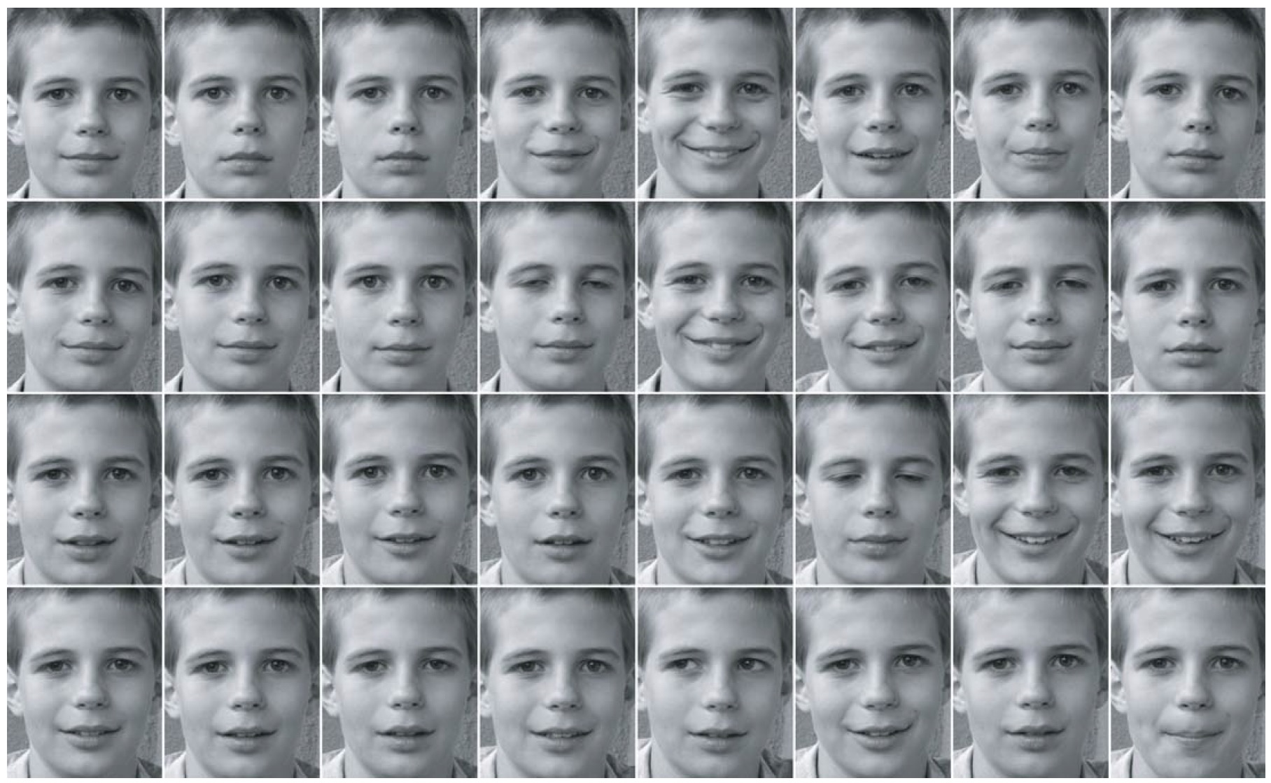
What if we have 32 instances of images

Slide 72
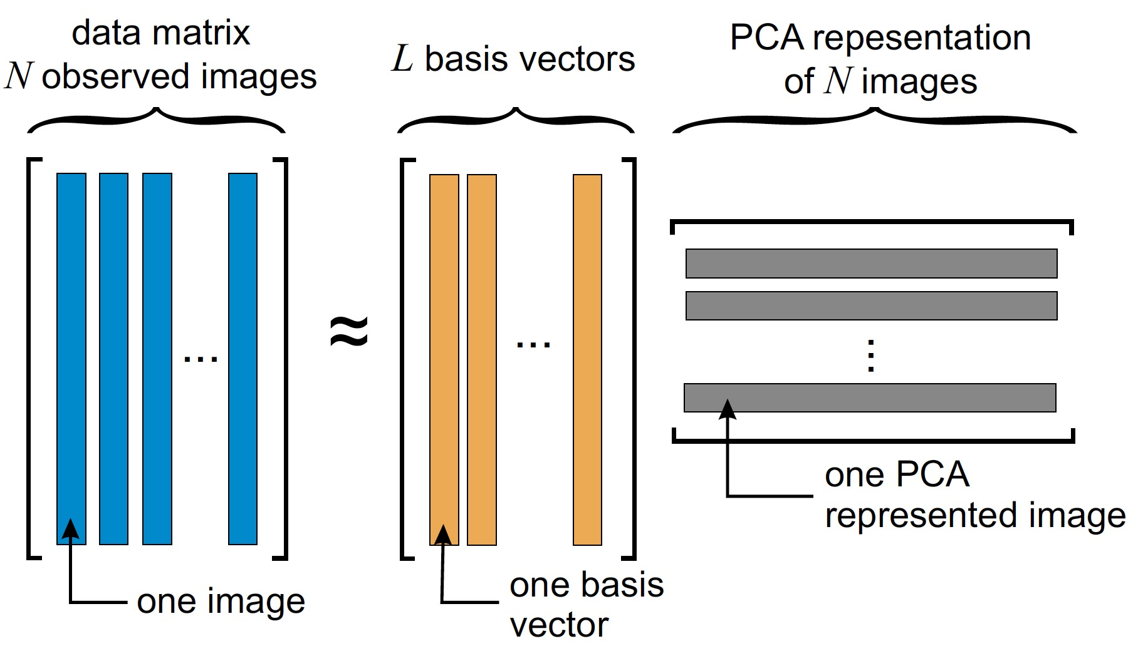
PCA: graphical illustration

Slide 73
PCA for images
We have 32 observations and 83781 unknowns!
The number of principle components is less than or equal to 32.
The eigen-vectors we derive are called eigen-images, after rearranging back from the 1D vector to a rectangular image.
Let us perform the dimensionality reduction from 32 to 4.

Slide 74
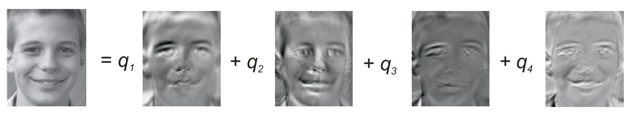
Approximation by 4 principal components only
Reconstruction of the image from four basis vectors b_{i}, i = 1, . . . , 4 which can be displayed as images.
The linear combination was computed as q₁b₁ + q₂b₂ + q₃b₃ + q₄b₄ = 0.078 b₁ + 0.062 b₂ − 0.182b₃+ 0.179 b₄.

Slide 75
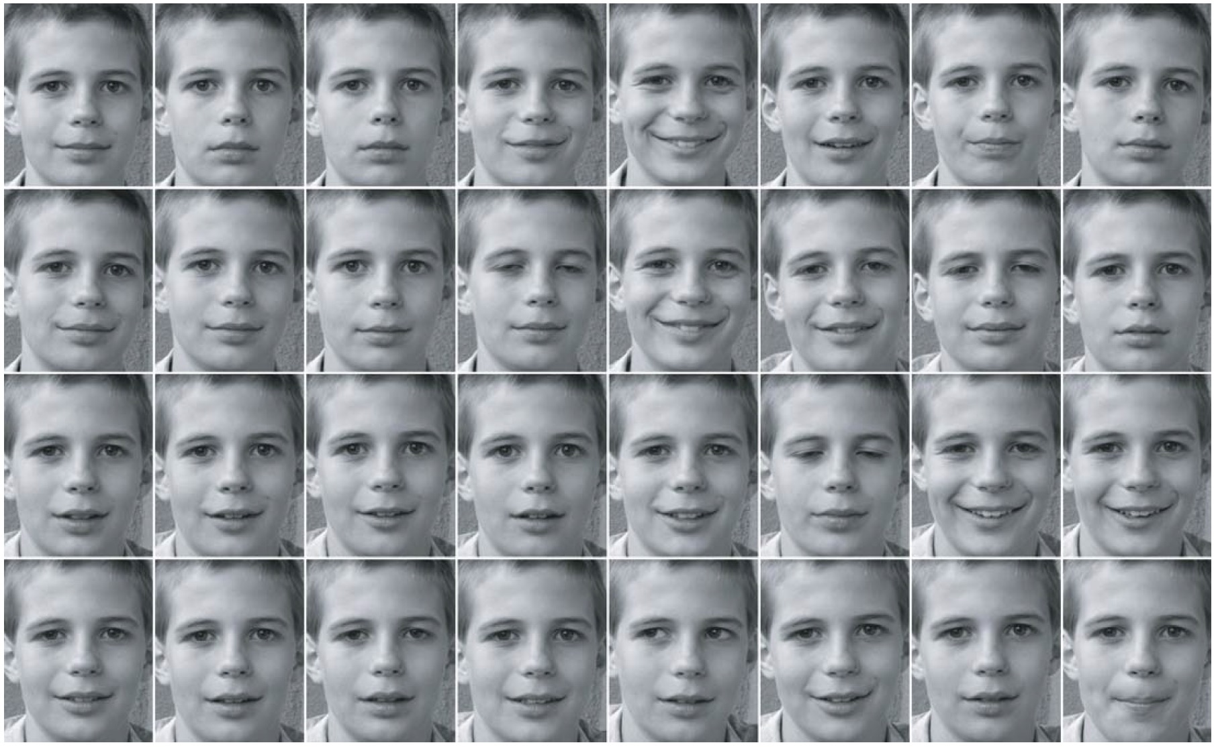
Reconstruction fidelity, 4 components

Slide 76
Reconstruction fidelity, original

Slide 77
PCA for Images - Drawbacks
By rearranging pixels column by column to a 1D vector, relations of a given pixel to pixels in neighboring rows are not taken into account.
Another disadvantage is in the global nature of the representation; small change or error in the input images influences the whole eigen-representation. However, this property is inherent in all linear integral transforms.

Slide 78
Addendum: How is SVD computed?
If you’re interested, one computer algorithm to do it makes use of Eigenvectors

Slide 79
Eigenvector definition
Suppose we have a square matrix A. We can solve for vector x and scalar λ such that Ax= λx
In other words, find vectors where, if we transform them with A, the only effect is to scale them with no change in direction.
These vectors are called eigenvectors (German for “self vector” of the matrix), and the scaling factors λ are called eigenvalues
An m x m matrix will have ≤ m eigenvectors where λ is nonzero

Slide 80
Finding eigenvectors
Computers can find an x such that Ax= λx using this iterative algorithm:
x=random unit vector
while(x hasn’t converged)
x=Ax
normalize x
x will quickly converge to an eigenvector
Some simple modifications will let this algorithm find all eigenvectors

Slide 81
Finding SVD
Eigenvectors are for square matrices, but SVD is for all matrices
To do svd(A), computers can do this:
Take eigenvectors of AA^{T} (matrix is always square).
These eigenvectors are the columns of U.
Square root of eigenvalues are the singular values (the entries of Σ).
Take eigenvectors of A^{T}A (matrix is always square).
These eigenvectors are columns of V (or rows of V^{T})

Slide 82
Finding SVD
Moral of the story: SVD is fast, even for large matrices
It’s useful for a lot of stuff
There are also other algorithms to compute SVD or part of the SVD

